Slide 1

Project information session

Slide 2
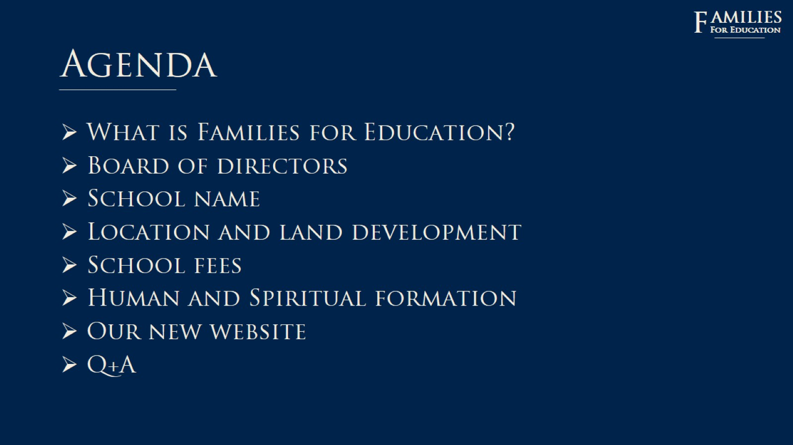
Agenda

Slide 3

amilies

Slide 4

History

Slide 5
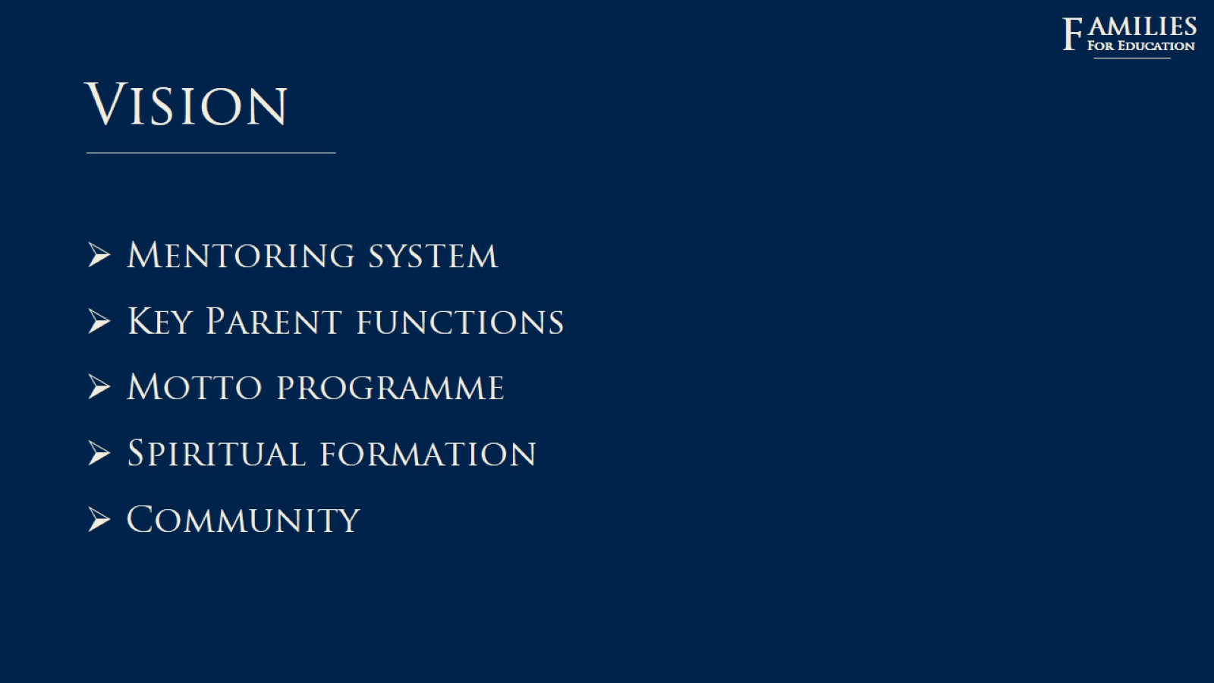
Vision

Slide 6
amilies

Slide 7
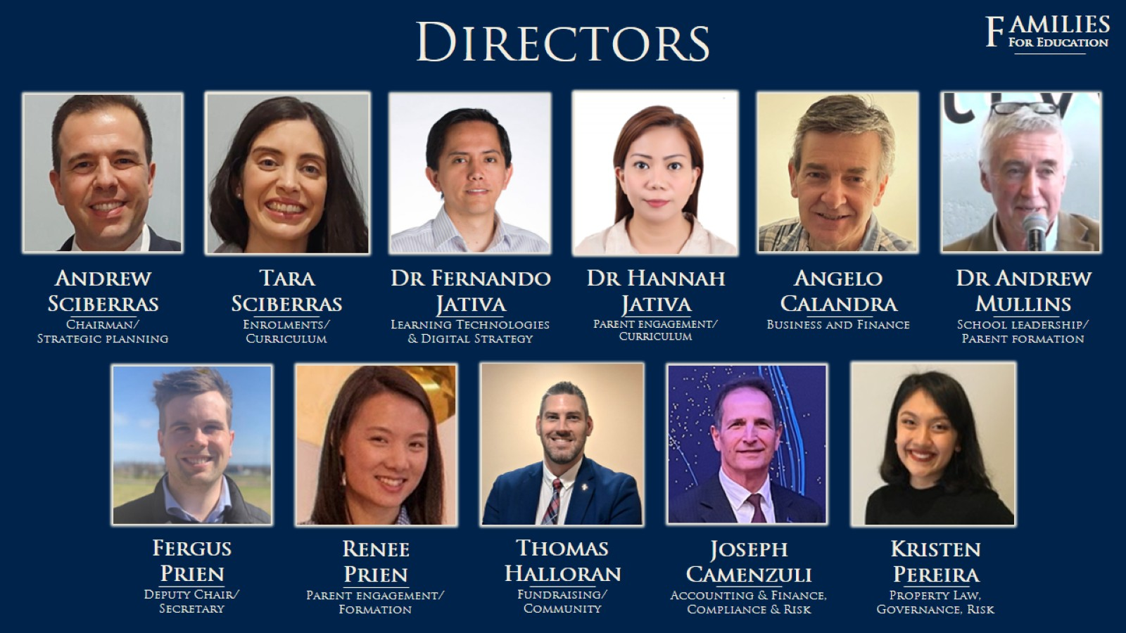

Slide 8
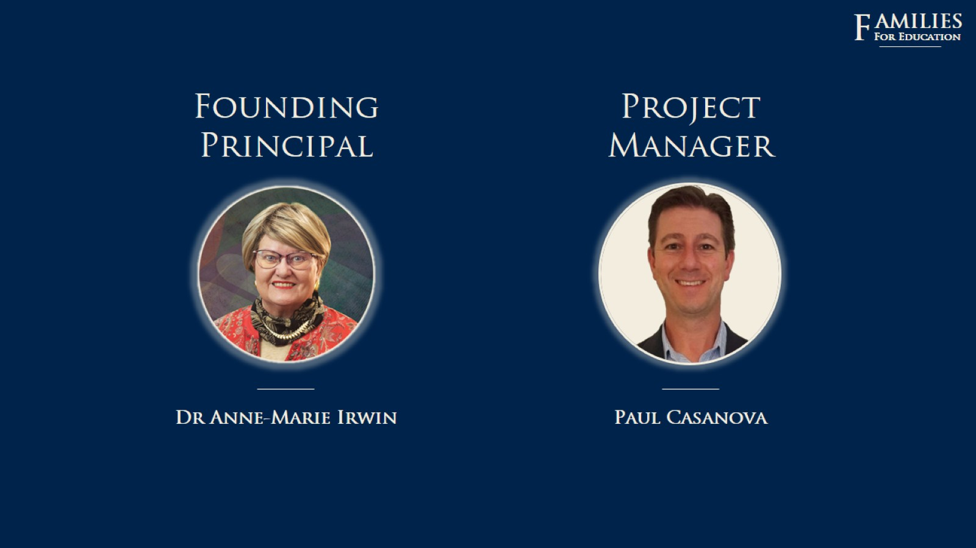

Slide 9

Our new school

Slide 10


Slide 11


Slide 12
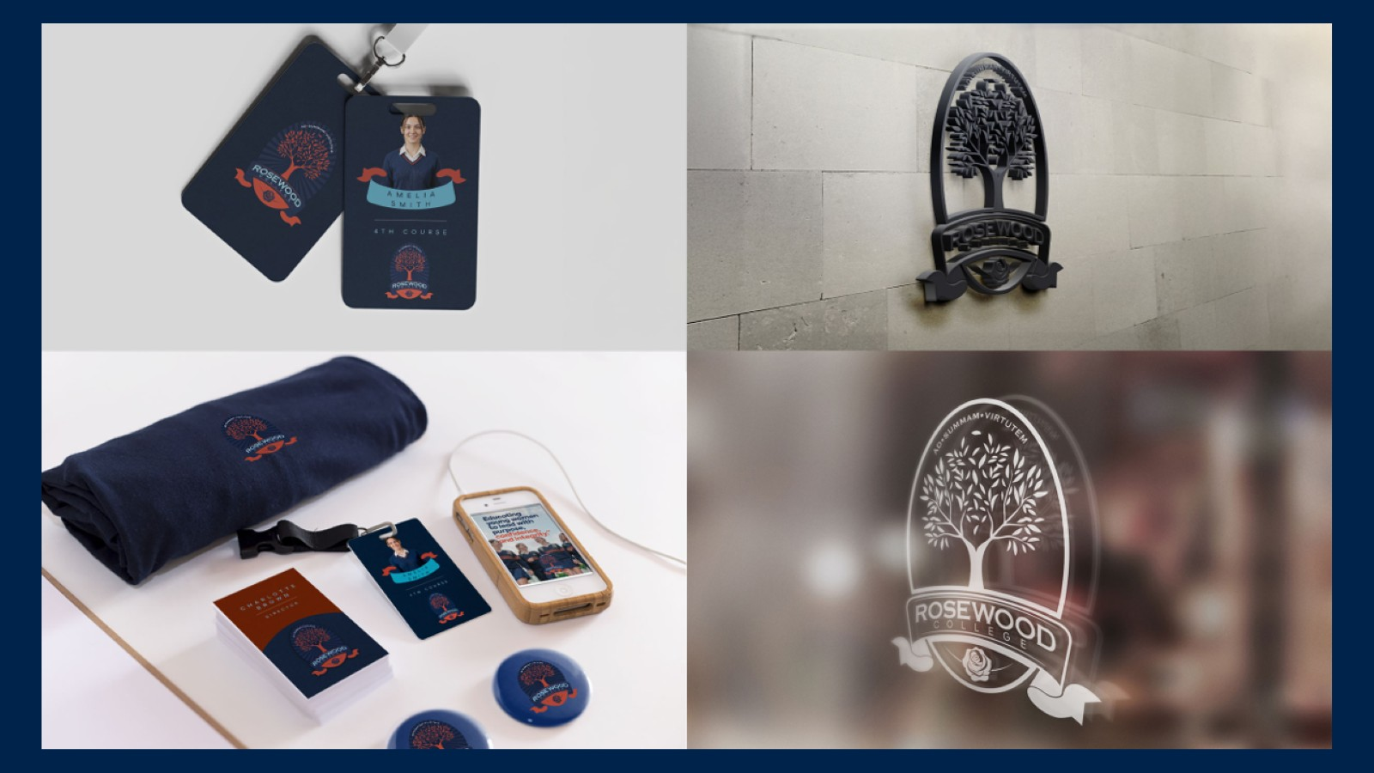

Slide 13
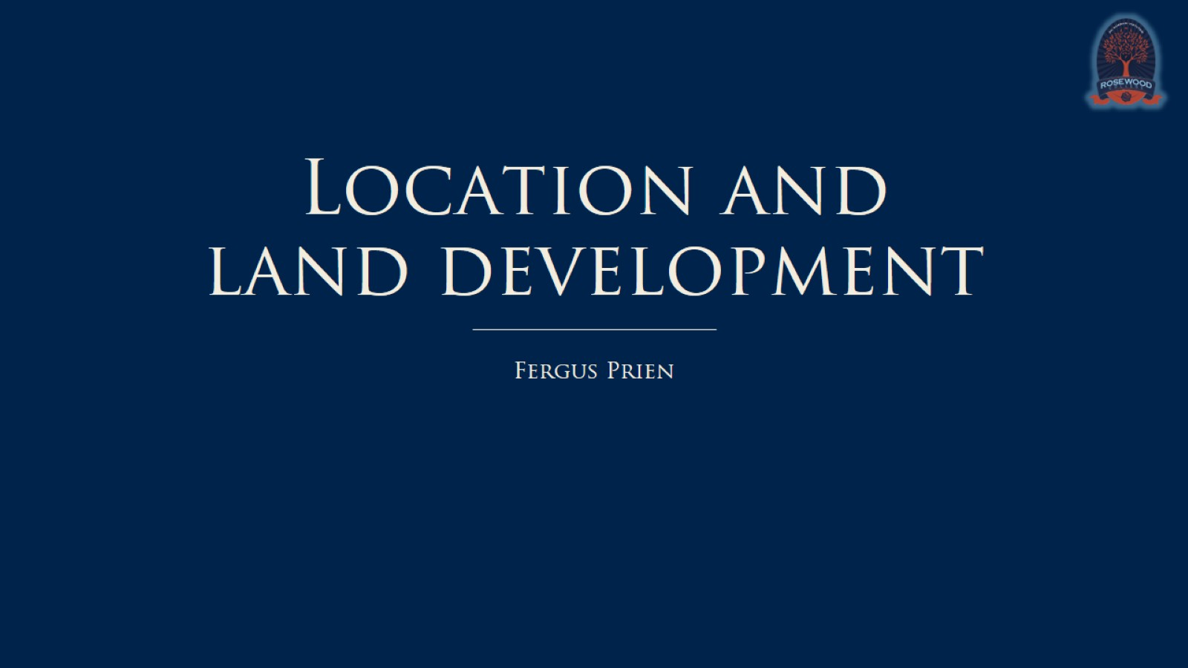
Location and land development

Slide 14
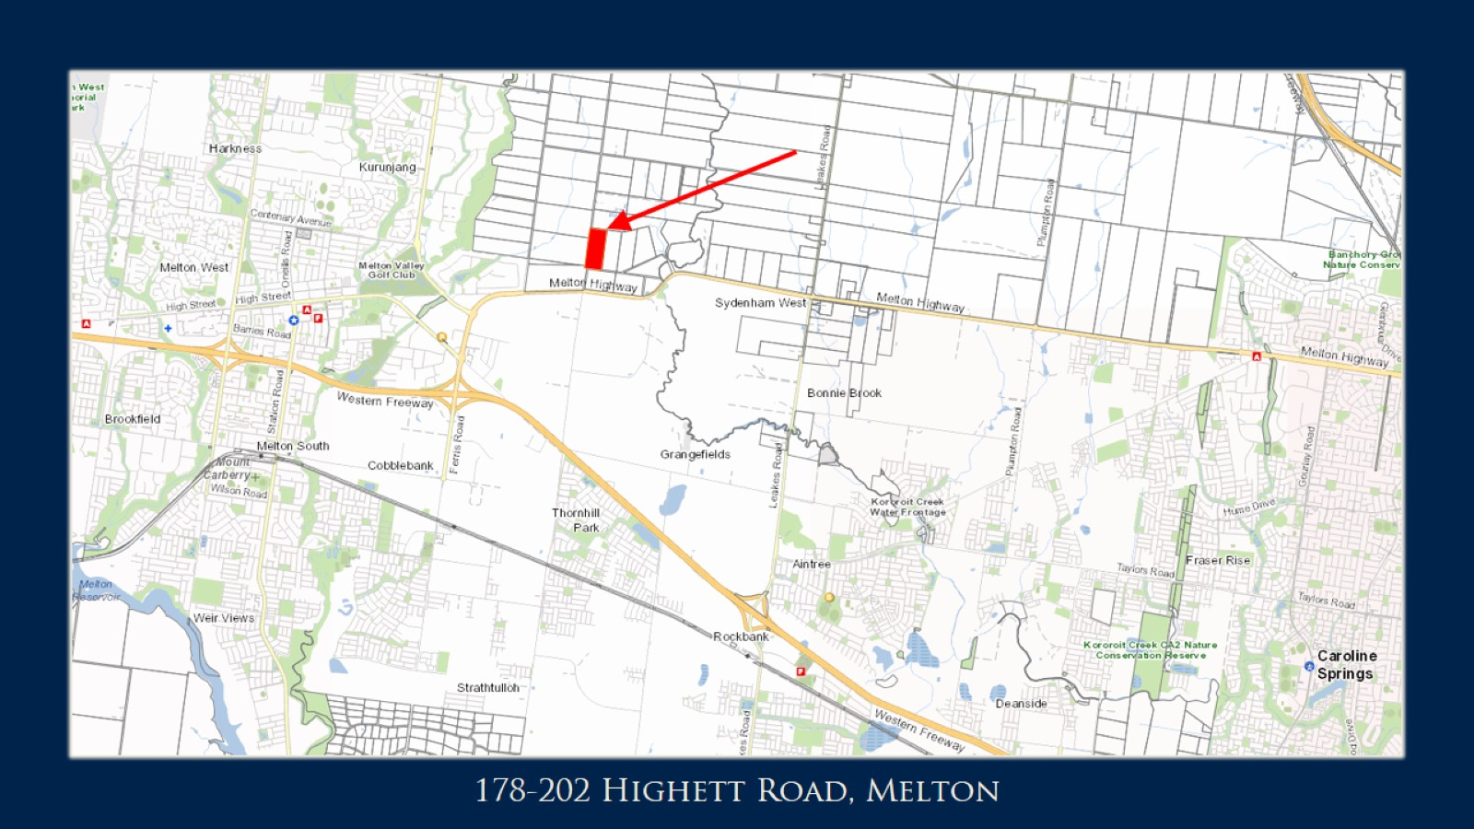

Slide 15
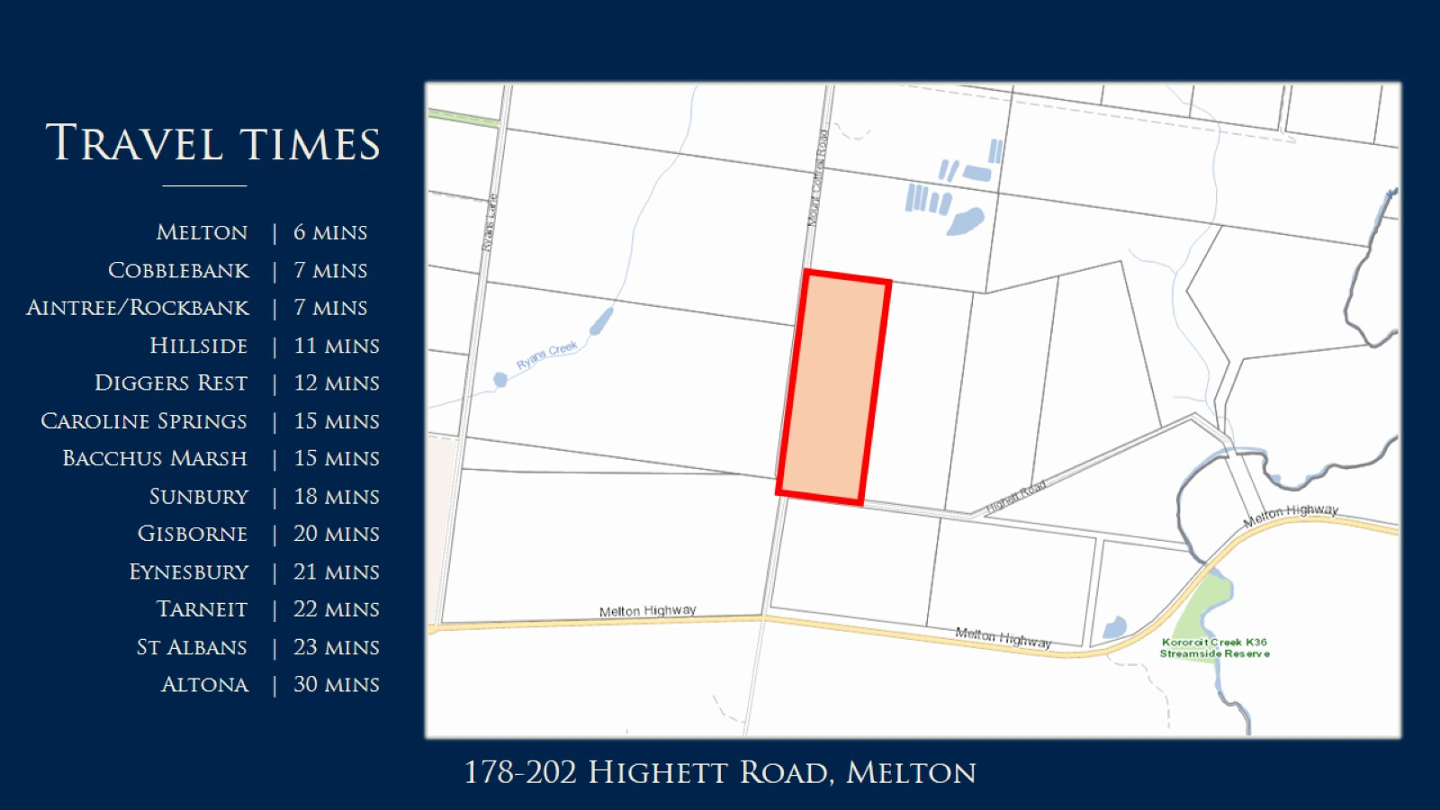

Slide 16
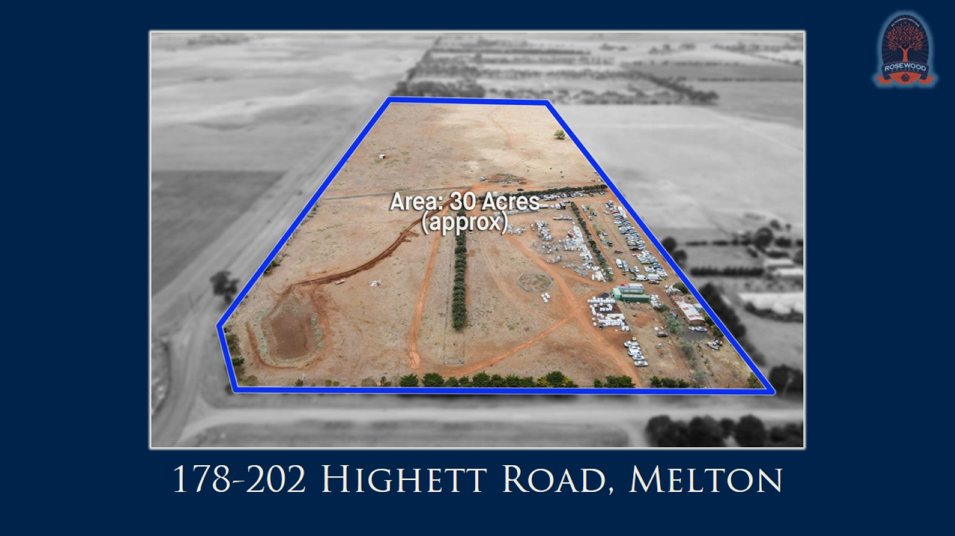

Slide 17
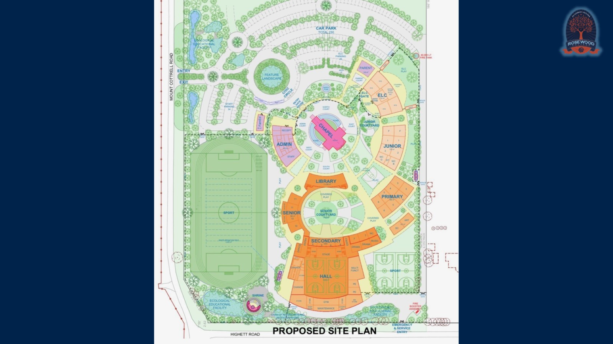

Slide 18
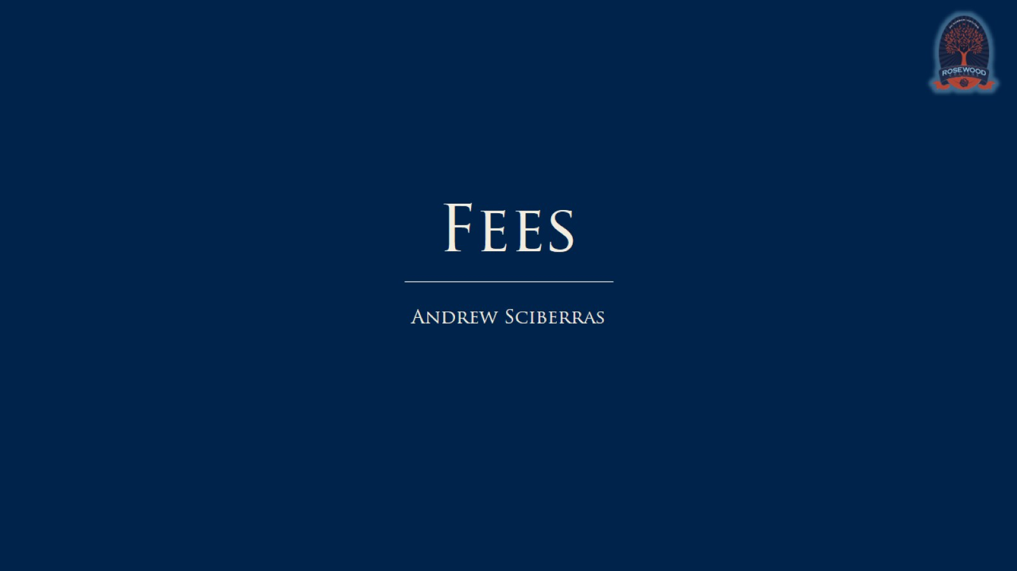
Fees

Slide 19
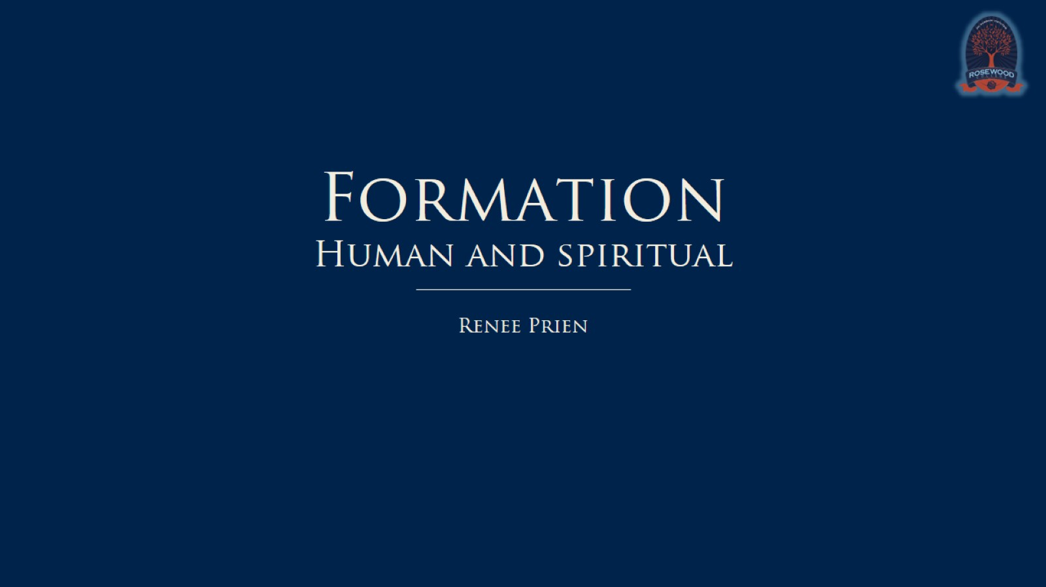
Formation Human and spiritual

Slide 20
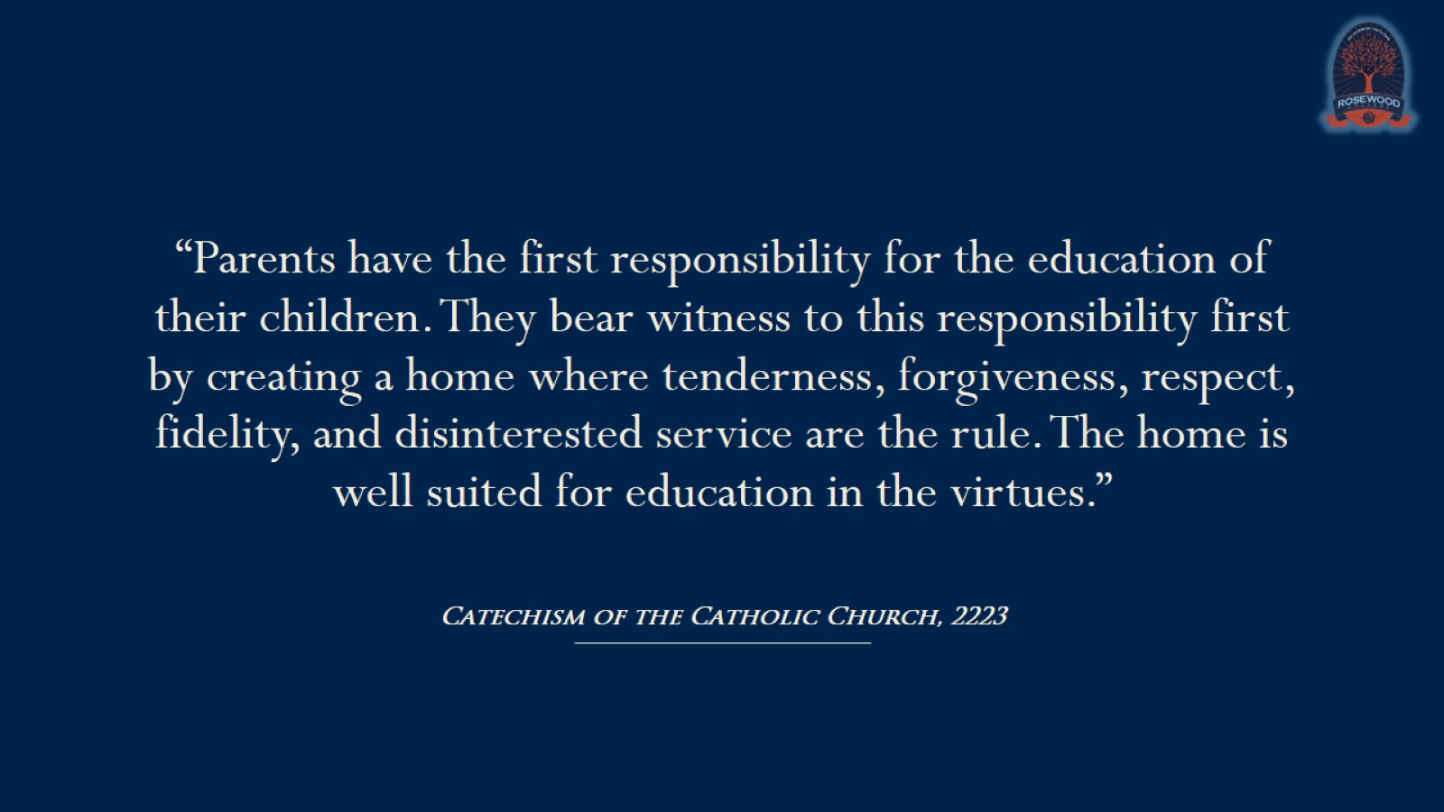

Slide 21
Formation Human and spiritual

Slide 22


Slide 23


Slide 24
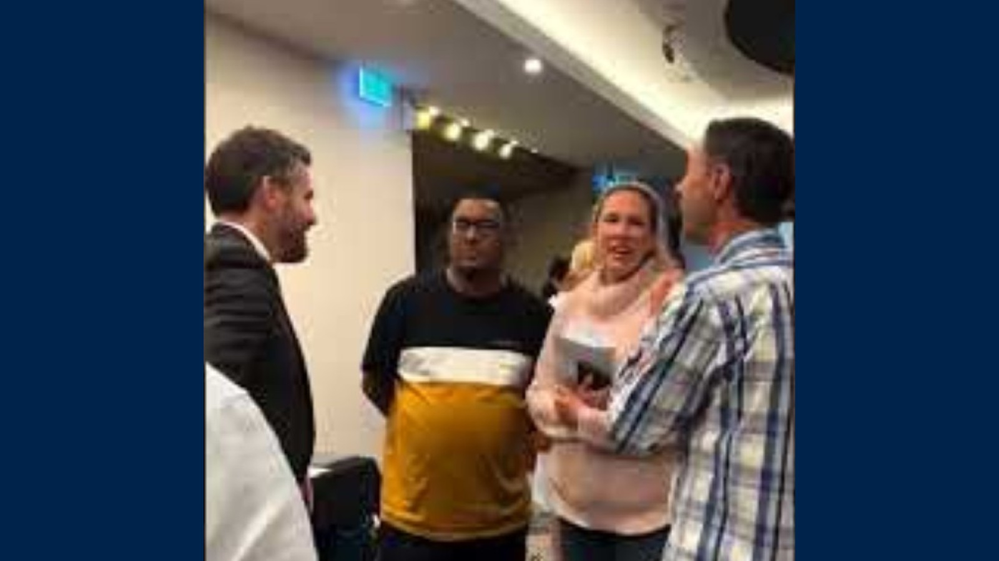

Slide 25

Next event

Slide 26

Our new website

Slide 27

Register your child

Slide 28


Slide 29

Q+A

Slide 30
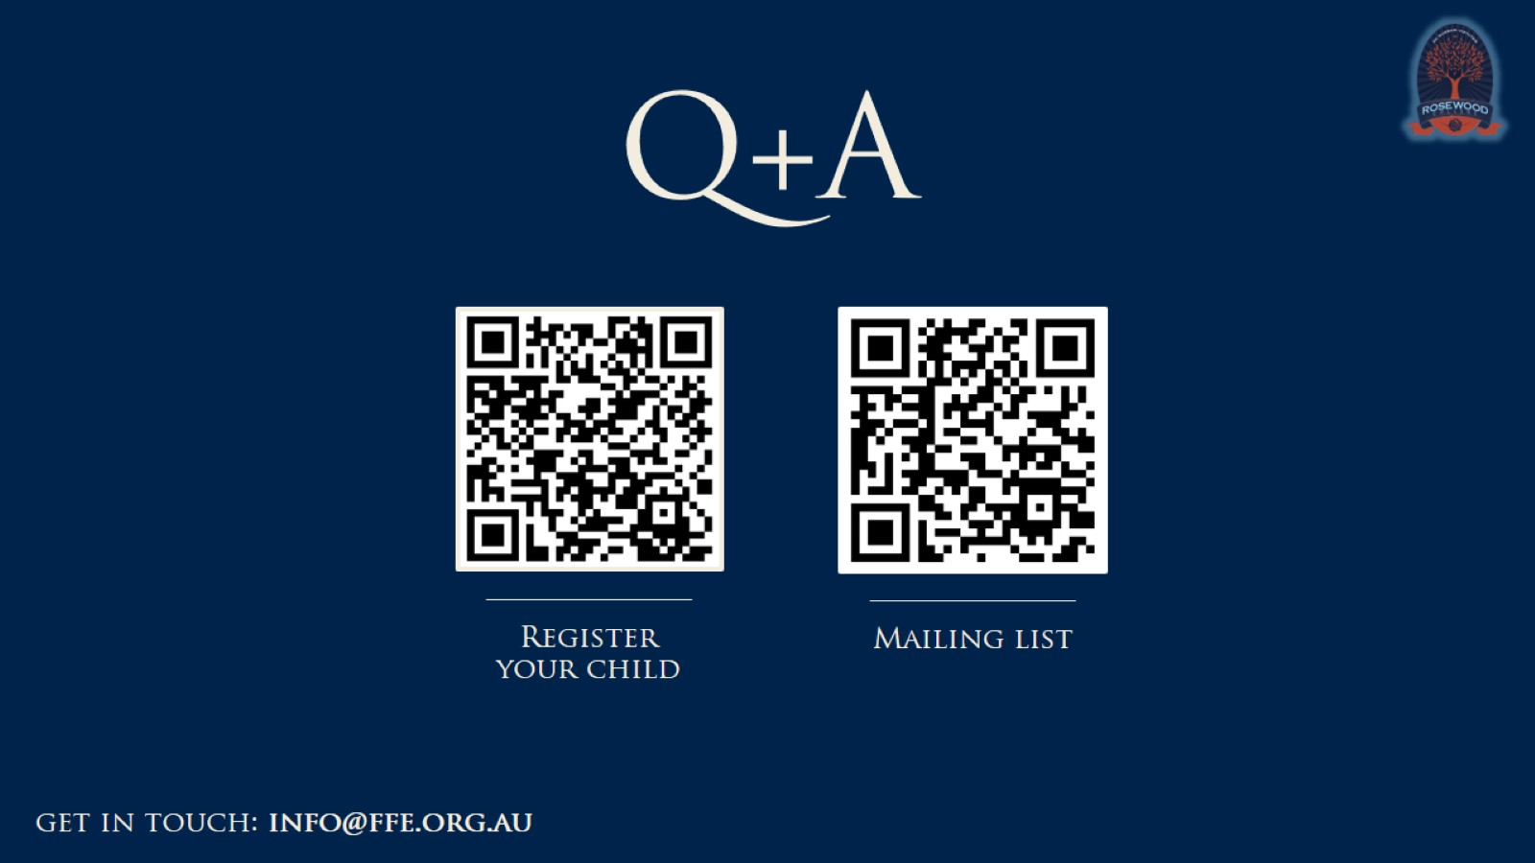
Q+A

